Slide 1
Data Set:
DC Building
Energy Benchmarks
Team DC20076
February 29th, 2020
UMD Data Challenge 2020

Slide 2
The Problem

Slide 3
Background
GHG Emission
Tonnage
Intensity
Weather Normalized Site Energy Use Intensity (EUI) kBTU
Energy Star Score
Building Types

Slide 4
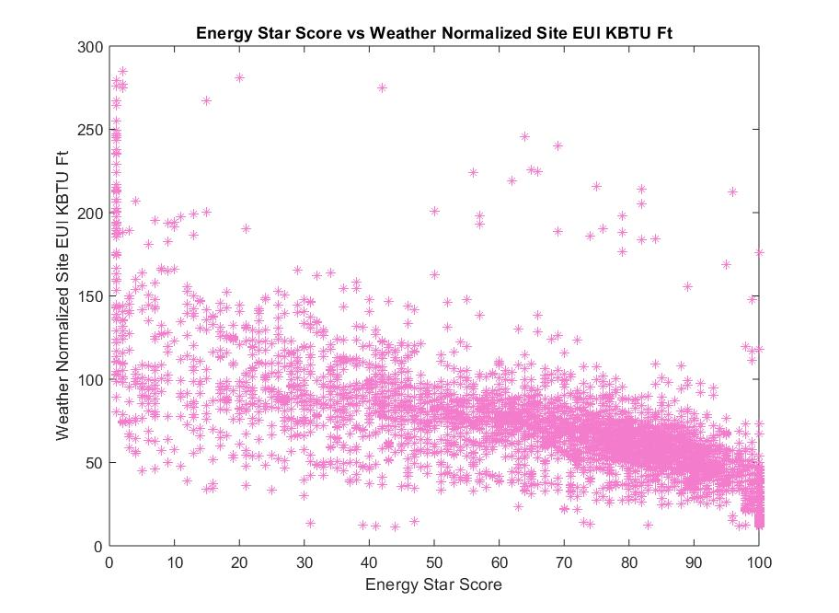

Slide 5
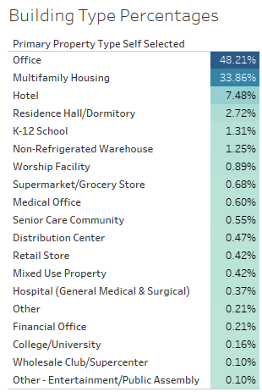

Building Type
Percentages
Count
Top 4
Office
Multifamily Housing
Hotel
Residence Hall / Dormitory
Data Points - “stable”
TOTAL
3800
Notes:
We break these up by decade because different eras of construction

Slide 6
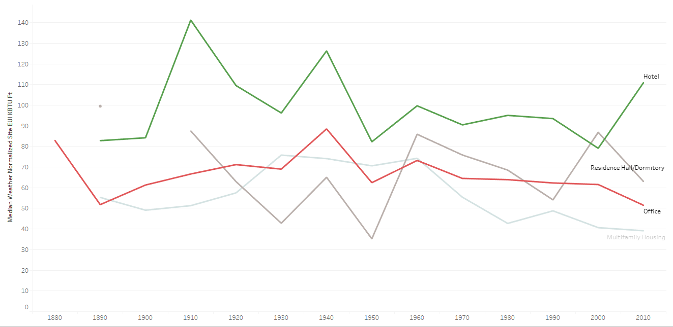
Weather Normalized Site EUI (by Year Built)
Year Built by Decade

Slide 7
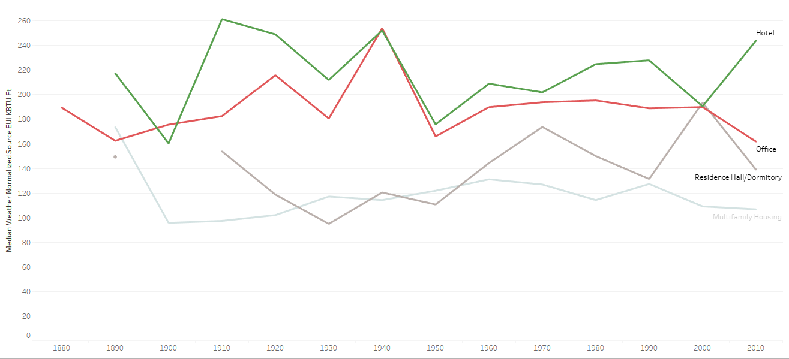
Weather Normalized Source EUI (by Year Built)
Year Built by Decade

Slide 8
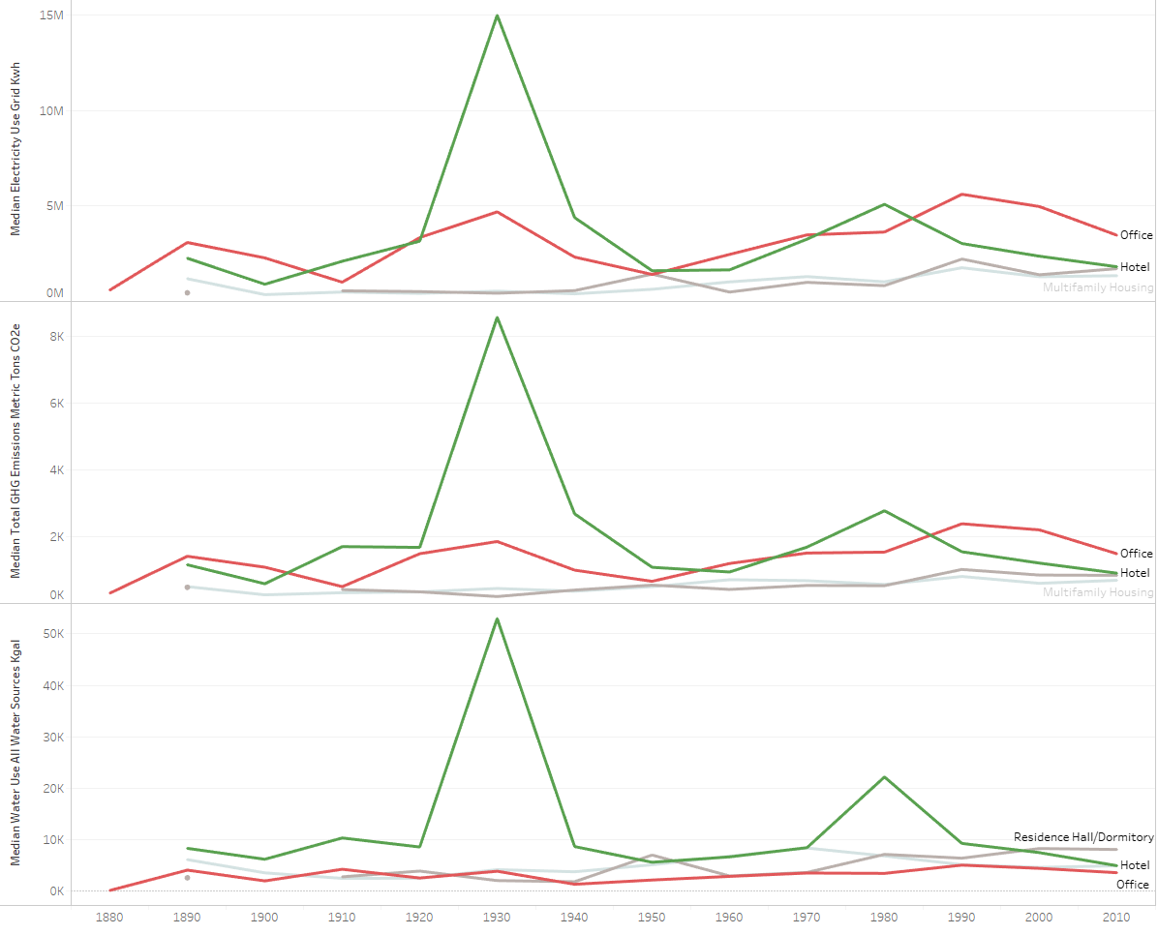
Normalized Electricity Use, GHG Emission Tonnage, Water Use
(by Year Built)
Median
Electricity Use
(Grid kWh)
Median
GHG
Emission
(Metric Tons)
Median
Water Use
Year Built by Decade

Slide 9
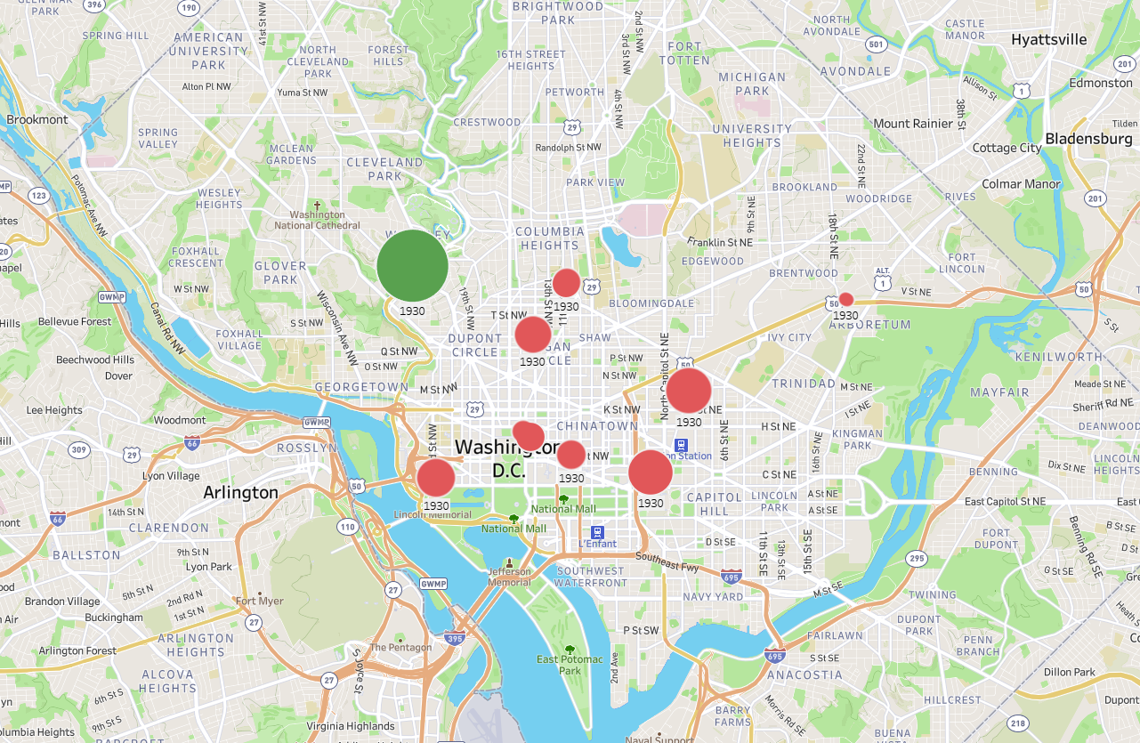
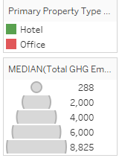
Median GHG Emissions by Building Type in 1930

Slide 10
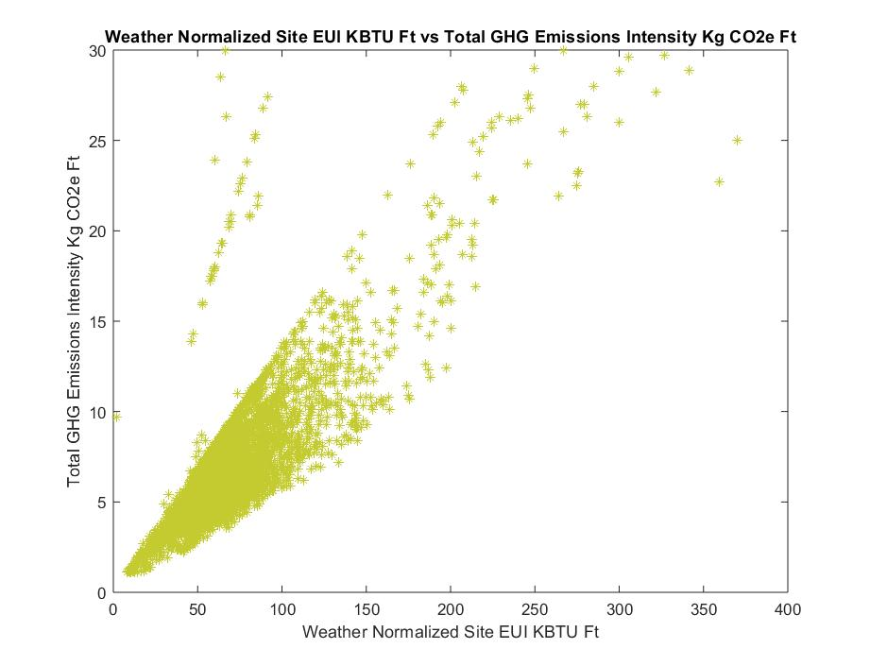

Slide 11
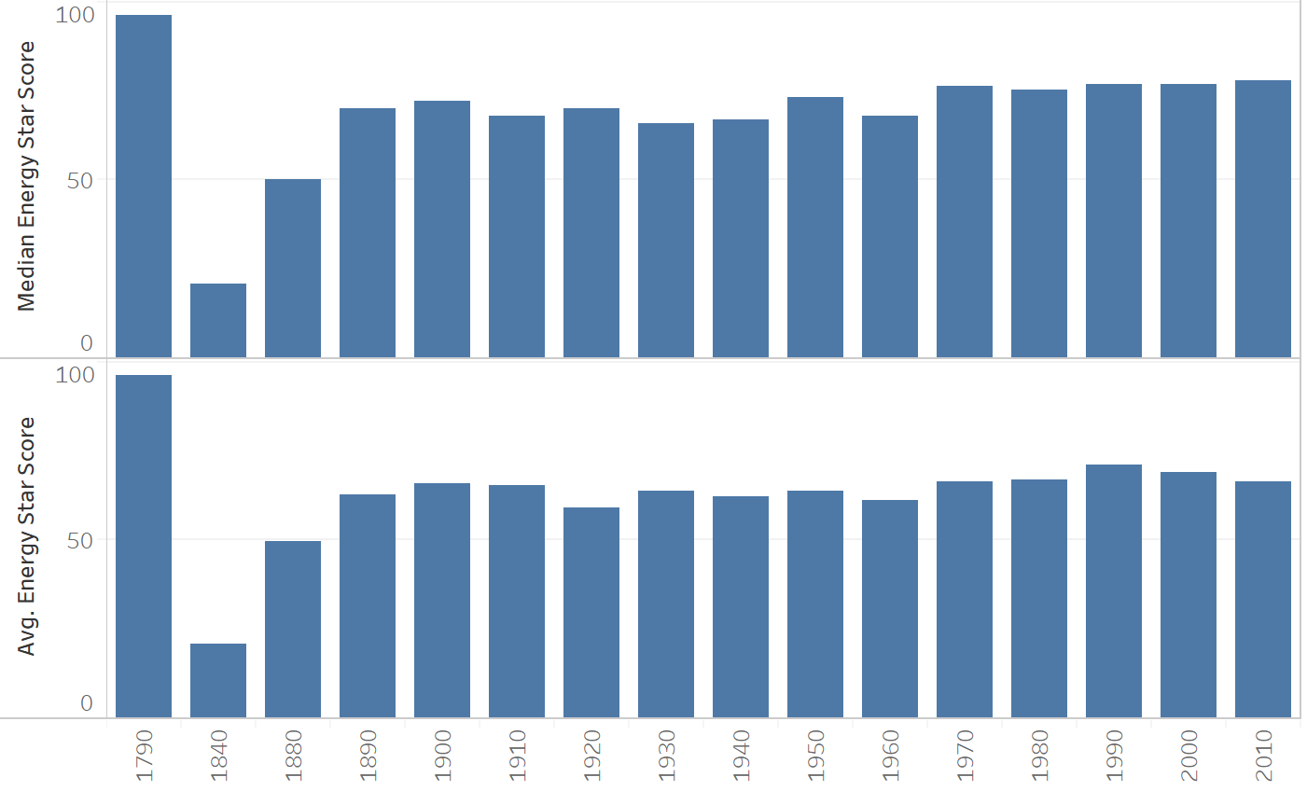
Does Energy Efficiency Decrease With Newer Buildings?

Slide 12
Future Considerations
LEED Certifications
Does having a certification impact a building’s energy efficiency?
Changes in Construction over time
What design principles yield the best energy efficiency?

Slide 13
Conclusions
Notes:
Significant variations in energy use in buildings constructed in certain decades could give clues as to technologies or design principles that could contribute to better or worse energy performance

Slide 14
Questions?

Slide 15
Thank You!

